Slide 1
Small Network Implementation
Introducing the Review Lab

Slide 2
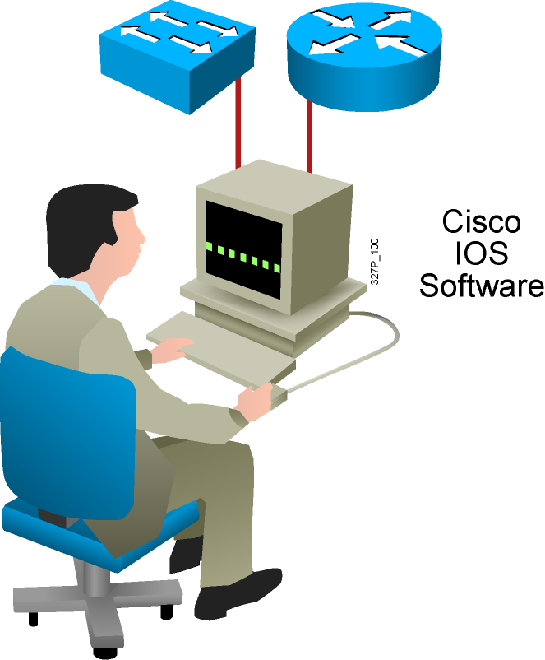
Cisco IOS User Interface Functions
  The CLI is used to enter commands.
  Operations vary between routers and
  switches, but both use the same CLI.
  The Enter key instructs a device to parse
  and execute a command.
  The CLI uses a hierarchy of commands
  in its configuration-mode structure.
  Users may type or paste entries within
  the console configuration modes.
  Configuration modes have distinctive prompts.
  Two primary EXEC modes are user mode
  and privileged mode.
  Changes are not saved automatically.
Notes:
Purpose: This slide introduces the two Cisco IOS EXEC modes on the Catalyst 1900 switch and routers.
Emphasize: As you present this, describe the bullet points that can prepare your students to work with the Cisco IOS user interface.

Slide 3
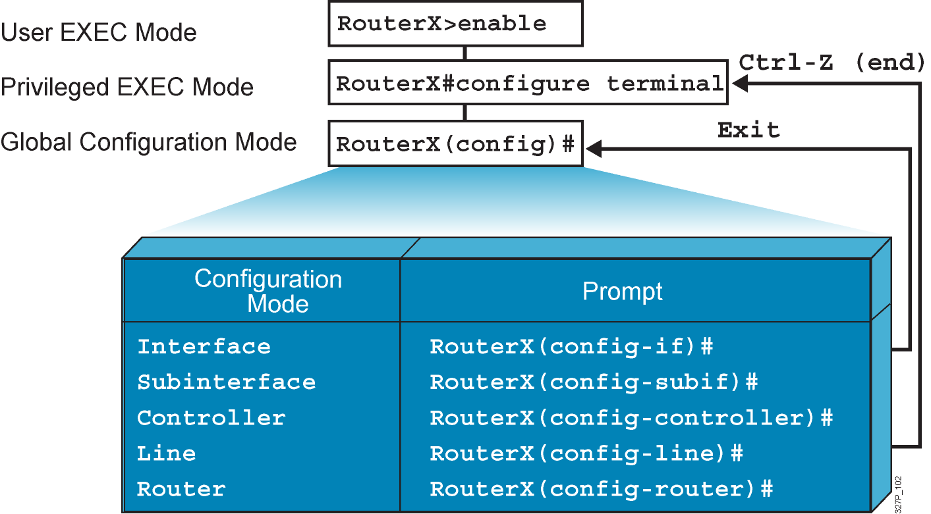
Overview of Cisco IOS
Configuration Modes
Notes:
Emphasize: Here is a list of some of the configuration modes available.
For a complete list of the router configuration modes, refer to the Cisco Documentation CD-ROM.

Slide 4
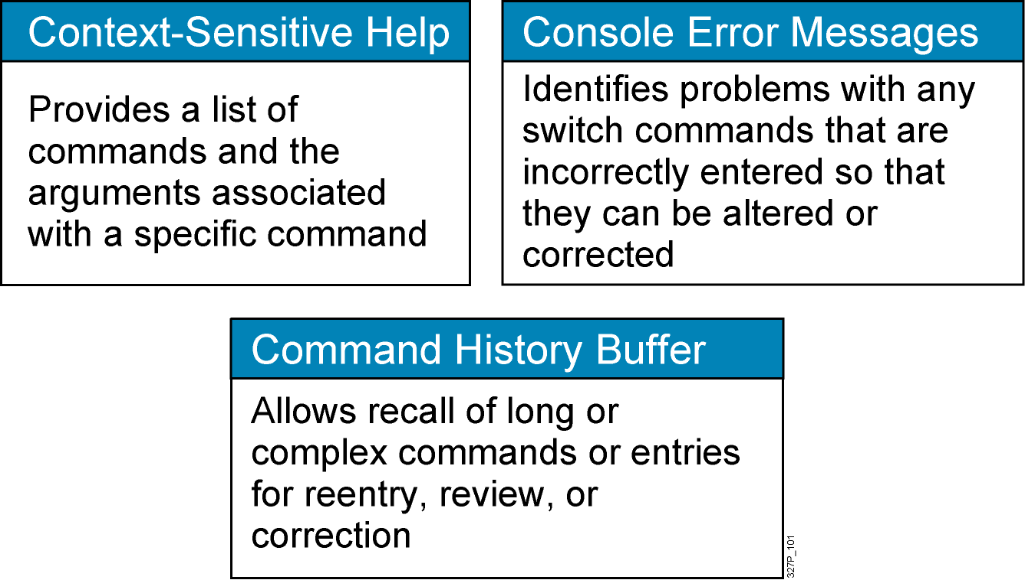
Help Facilities of the Cisco IOS CLI
Notes:
Purpose: This slide describes the Help facilities on the Catalyst 1900 switch.
Emphasize: After showing how to log in to the Catalyst 1900 Cisco IOS CLI and enabled EXEC privileged mode, use this slide to present the three main types of command-line help available.
This list is similar to, but not as extensive as the types of command-line help on the router that you present later with a similar slide.
If at this point you can demonstrate what you are presenting, so much the better.
The help on the switch is very similar to the help on the router, so the details are only presented once, in the router section.

Slide 5
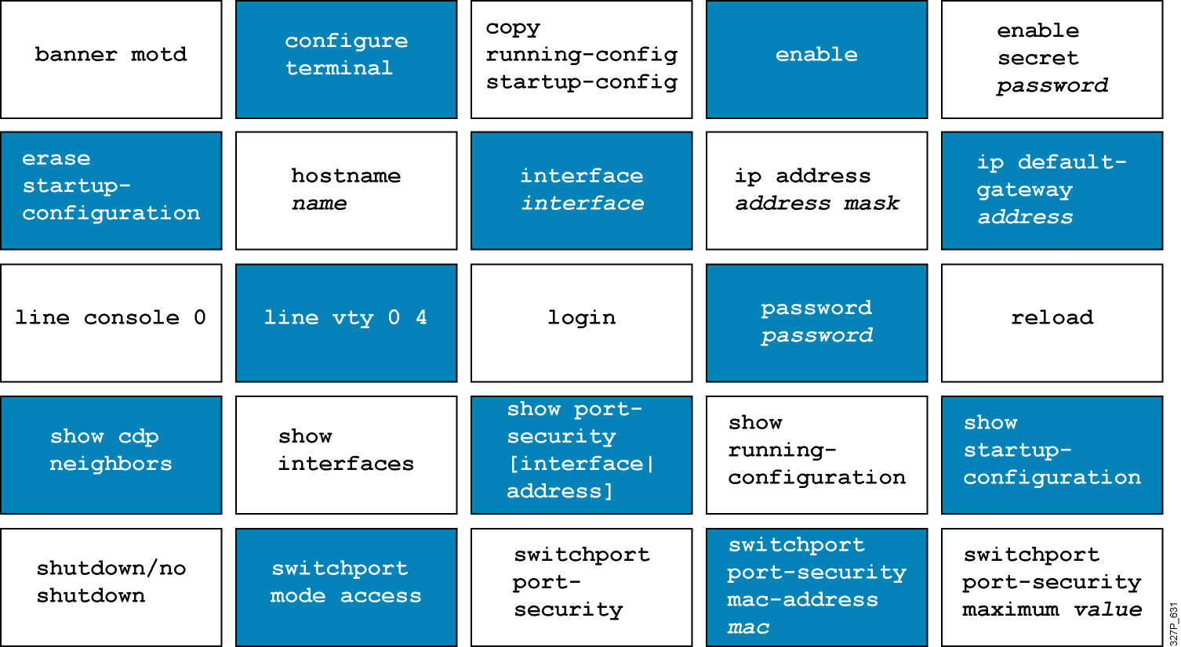
Commands Review Discussion
What does the command accomplish?
From what configuration mode is the command executed?

Slide 6
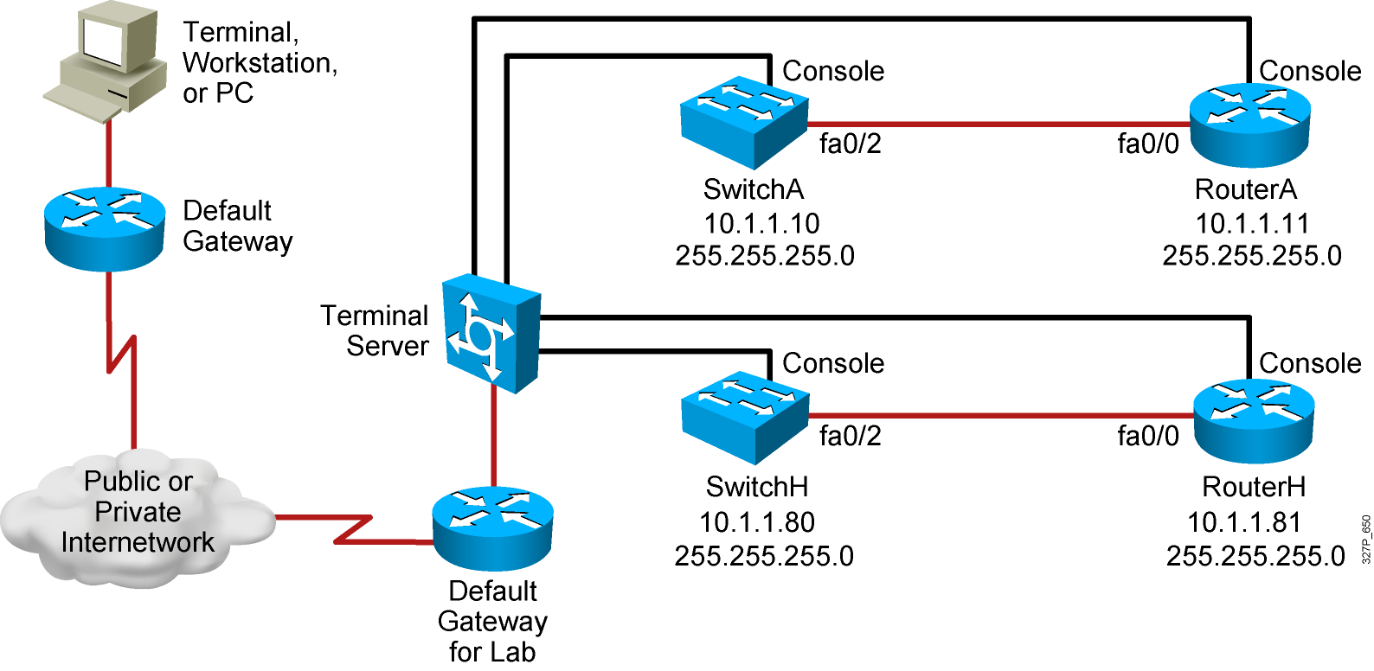
Access to the Remote Labs
Use this module review to complete an introductory lab,
which will become the basis for all subsequent lab activities.

Slide 7
Summary
  A basic router or switch configuration includes the provision of hostnames for identification, the provision of passwords for security, and the assignment of
  IP addresses for connectivity.
  You use the CLI to enter commands.
  You use the configure terminal command to enter global configuration mode. To exit global configuration mode you can use the command end or press Ctrl-Z.
  The CLI provides context-sensitive help, console error messages, and a command history buffer.

